Slide 1
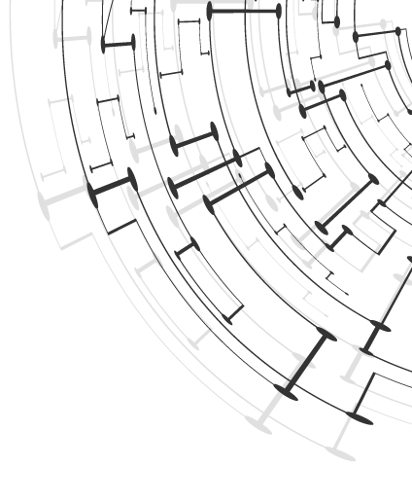
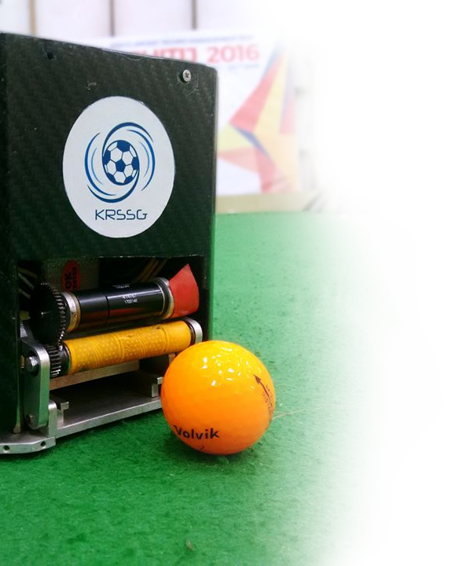


KRSSG
Kharagpur RoboSoccer Students’ Group
a student research project under
Department of Computer Science & Engineering
Indian Institute of Technology Kharagpur
SPONSORSHIP BOOKLET

Slide 2
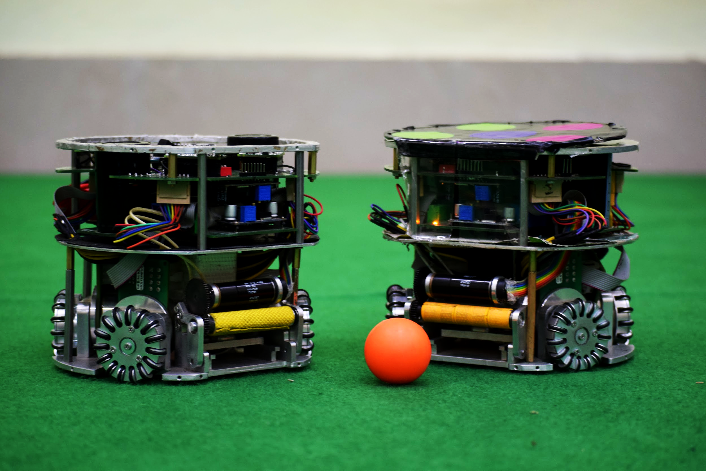
KRSSG
About US
Kharagpur RoboSoccer Students’ Group (KRSSG), is a research project previously under the aegis of SRIC, IIT Kharagpur and currently being moved under Center for Excellence in Robotics(CFeR), IIT Kharagpur. KRSSG is headed by Prof. Jayanta Mukhopadhyay, Department of Computer Science and Engineering & Prof. Alok Kanti Deb, Department of Electrical Engineering, IIT Kharagpur.
KRSSG currently participates in International Robot Soccer World Championship called “RoboCup” in its Soccer Leagues under the team name “KgpKubs”. We are looking for potential sponsors like you to support us for our research activities and our participation in RoboCup 2020 to be held in Bordeaux, France.
For more information about us visit: www.krssg.in

Slide 3
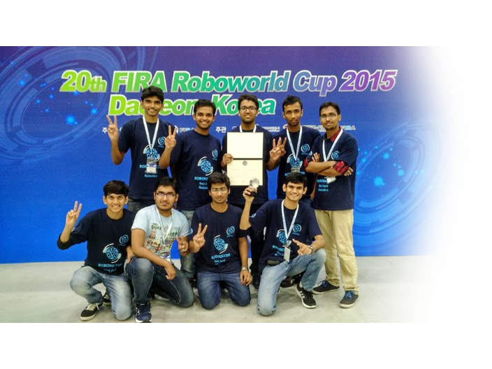




KRSSG
Facts
Established : 2009
Current Strength : 50
7 International
Participations in
ROBOCUP & FIRA
Bronze in FIRA 2015
Deajeon, Korea

Slide 4
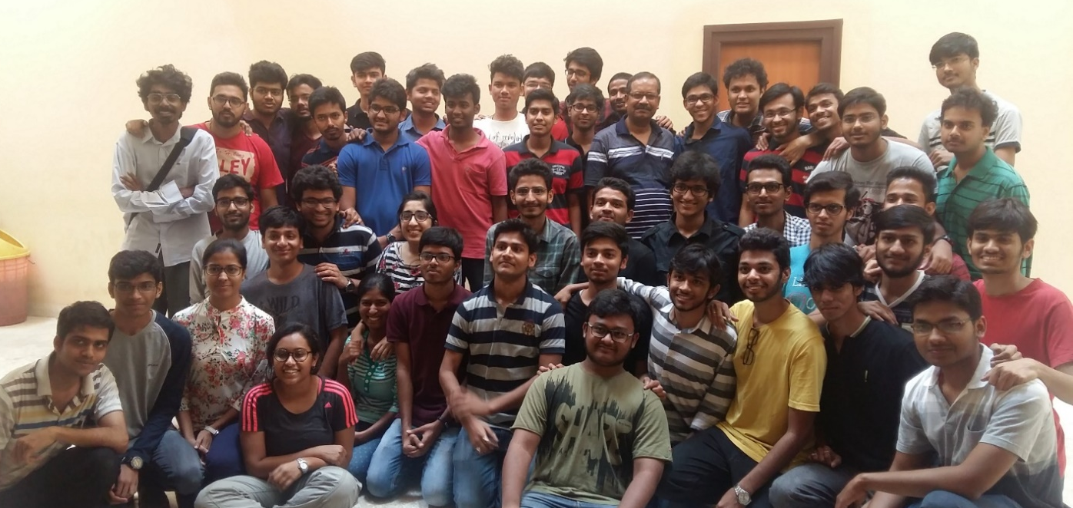
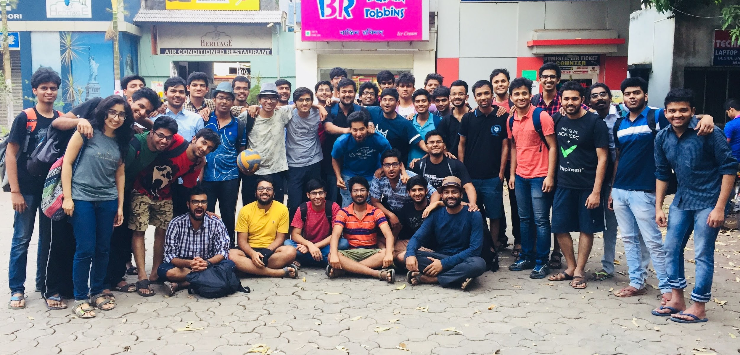
KRSSG
The Team
As a sponsor you’ll be supporting an internationally acting project with enthusiastic students from different courses of IIT Kharagpur.
Use this opportunity to advertise your company and technology on a new platform. Support us and find professionals for the work of tomorrow.
Participating Courses
Computer Science Engineering
Mathematics and Computing
Electrical Engineering
Electronic and Electrical Communication
Mechanical Engineering
Aerospace Engineering
Materials Engineering
Chemical Engineering

Slide 5



KRSSG
Competition
“By the year 2050, a team of fully autonomous humanoid robot soccer players shall win a soccer game, complying with the official rules of FIFA, against the winner of the most recent World Cup”
Established: 1997 in Japan
Number of Editions: 24
Participating Teams: 500
Participating Countries: 45
Total Participants: 3,500+
RoboCup is an annual international robotics competition proposed and founded in 1997. The goal of RoboCup organization is to use the publicly appealing platform of Robo-Soccer to promote research in Robotics and Artificial Intelligence(AI).
The competition currently has 6 major domains:
For more info on RoboCup visit: www.robocup.org and 2020.robocup.org
RoboCup
Soccer
RoboCup
Rescue
RoboCup
@Home
RoboCup
@Work
RoboCup
Logistics
RoboCup
Junior

Slide 6
KRSSG
Achievements
ROBOCUP 2016
Leipzig, Germany
First Participation in Robocup
3D Simulation League
ROBOCUP ASIA PACIFIC 2017
Bangkok, Thailand
Won BRONZE in the 3D Simulation League
FIRA 2010
Bangalore, India
FIRA 2014
Beijing, China
FIRA 2013
Kuala Lumpur, Malaysia First Indian Team to win International MiroSot Match
FIRA 2015
Daejeon, Korea First Indian Team to win BRONZE in International MiroSot League
ROBOCUP 2017
Nagoya, Japan
Participated in SSL League Qualified for Quarter Finals in 3D Simulation League
ROBOCUP 2018
Montreal, Canada
Secured SILVER in Skills Challenge in 3D Simulation League

Slide 7
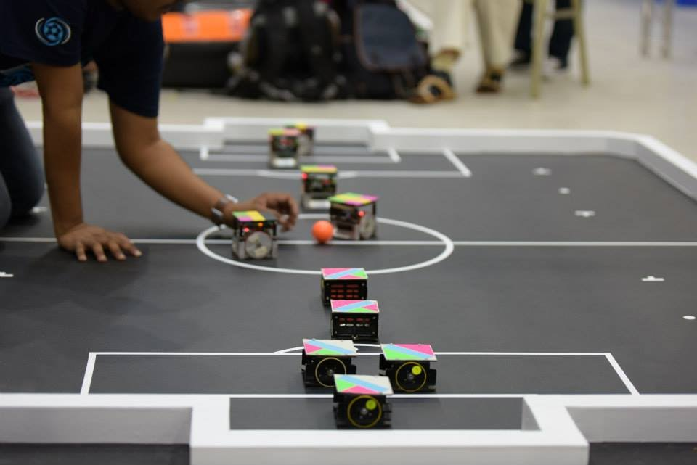
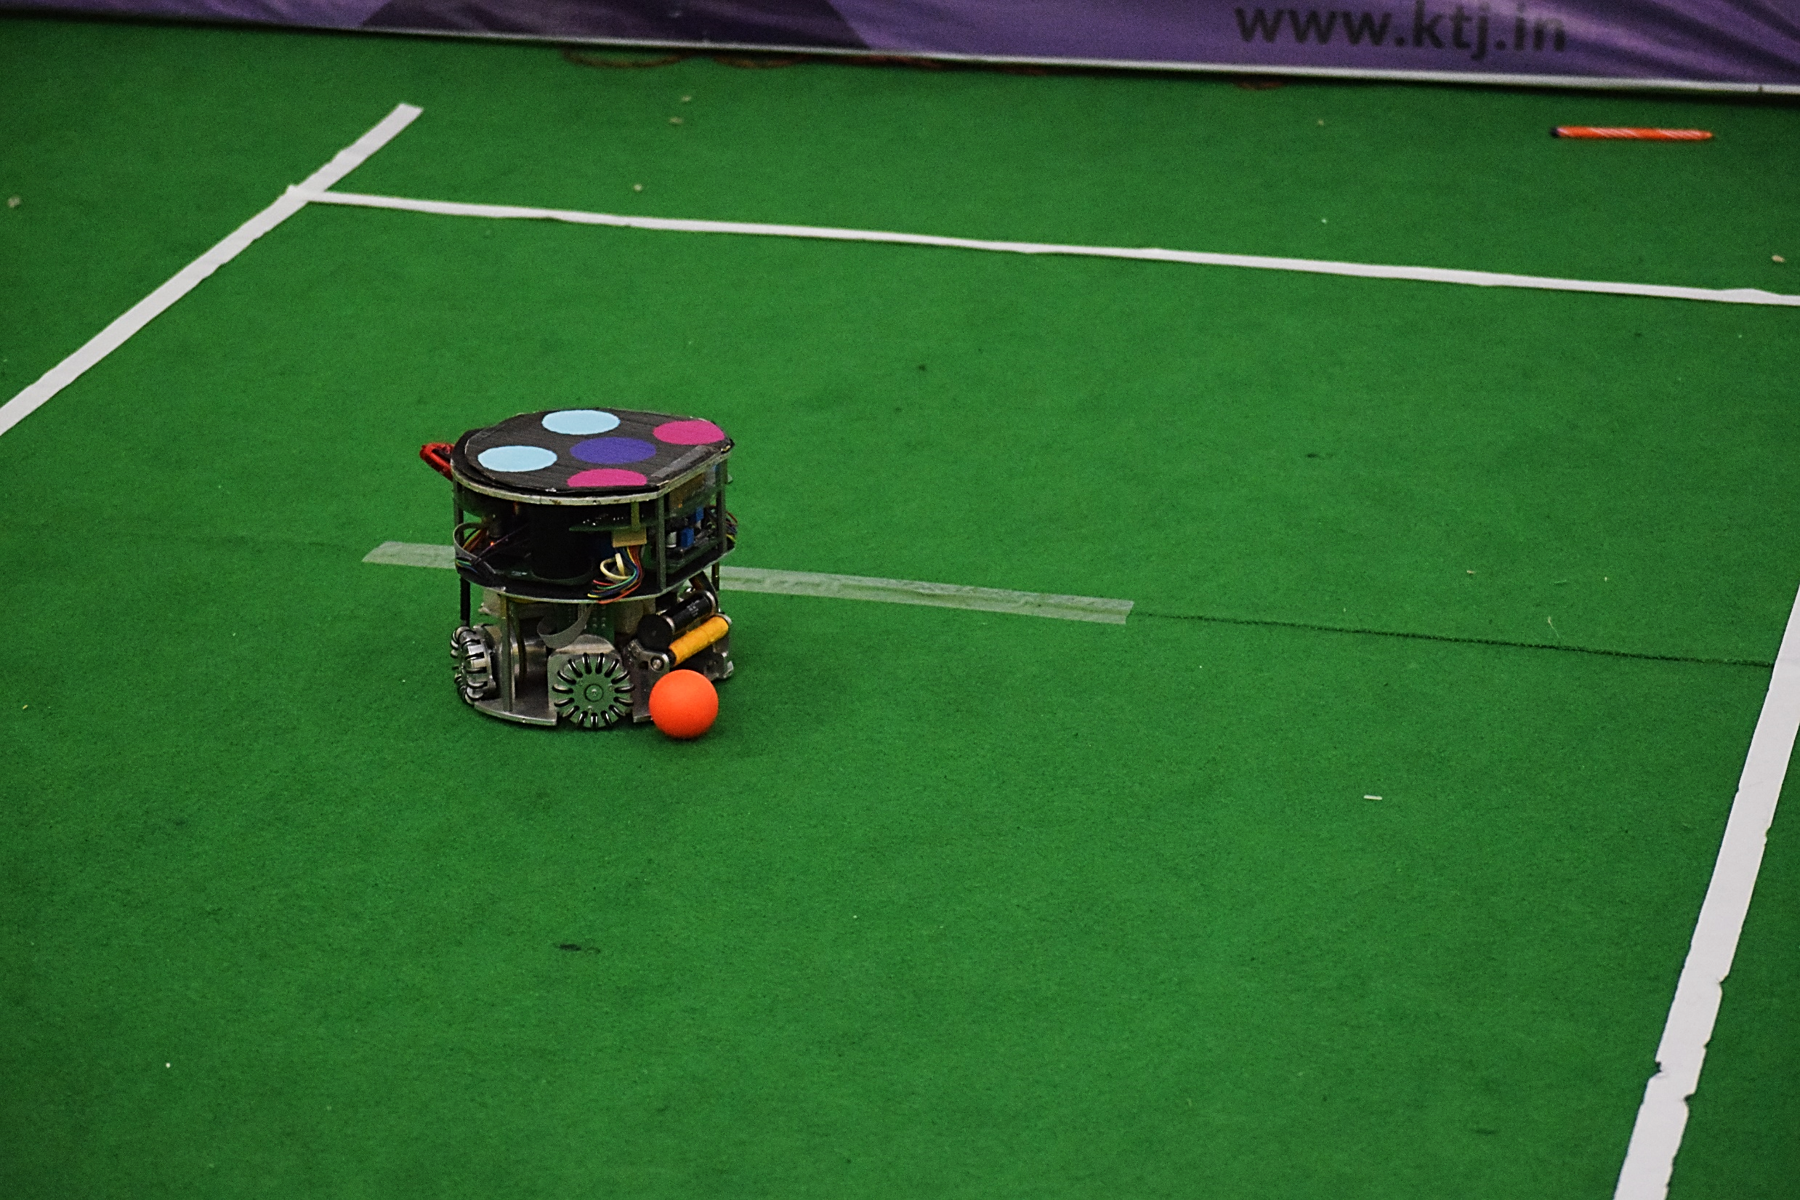
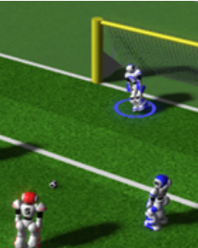
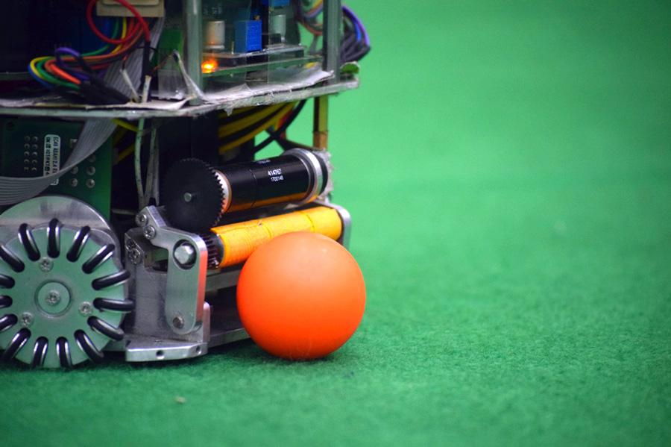
KRSSG
The Technology
The robots of KRSSG are a proprietary development. Mechanics and electronics have been specially designed from scratch. We use advanced artificial intelligence techniques for centralised bot control and game developments.
Differential Drive
7.5cm * 7.5cm * 7.5cm
Max Speed: 10 m/s
Omnidirectional Drive
15cm Height, 18cm Diameter
Max Speed: 12 m/s
Max Kick Speed: 8 m/s
11 vs 11 bots
Humanoid Simulation Software
Working on Humanoid Robots

Slide 8
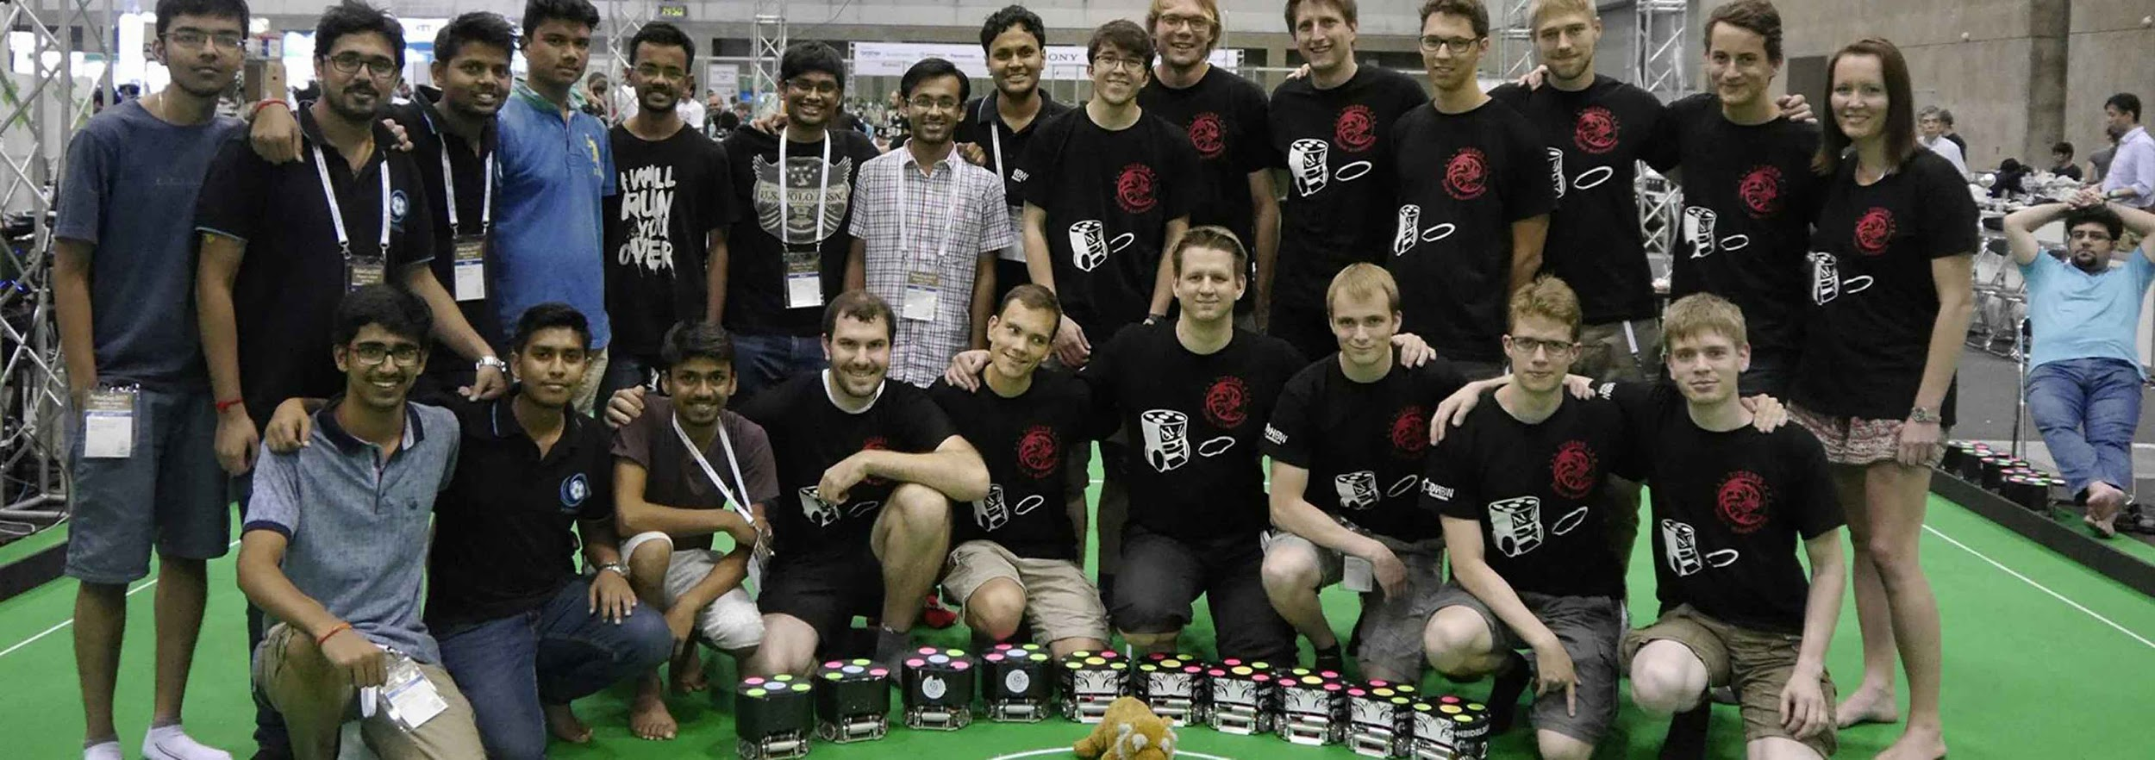
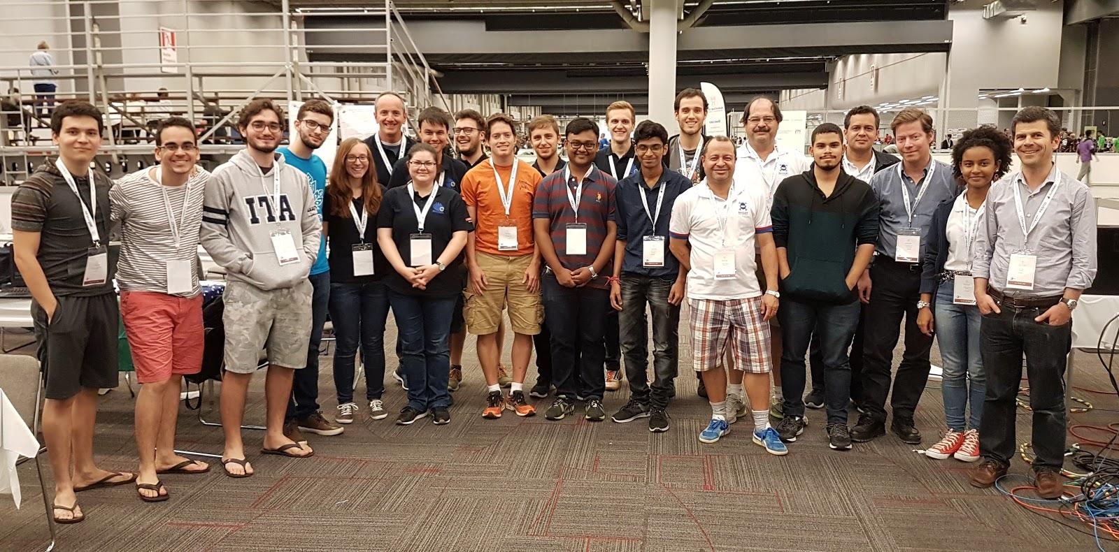
KRSSG
International Branding
KRSSG has been participating in international competitions from last 10 years. We started by taking part in FIRA and then shifted to Robocup after winning bronze in MiroSot league, FIRA.
Each year we participate in 3D Humanoid simulation league and Small Size League(SSL) of RoboCup.
RoboCup
Expected Visitors:- Approx. 40,000
Participants: 3500 participants from 45 countries.
Audience: International Artificial Intelligence and Robotics community.

Slide 9
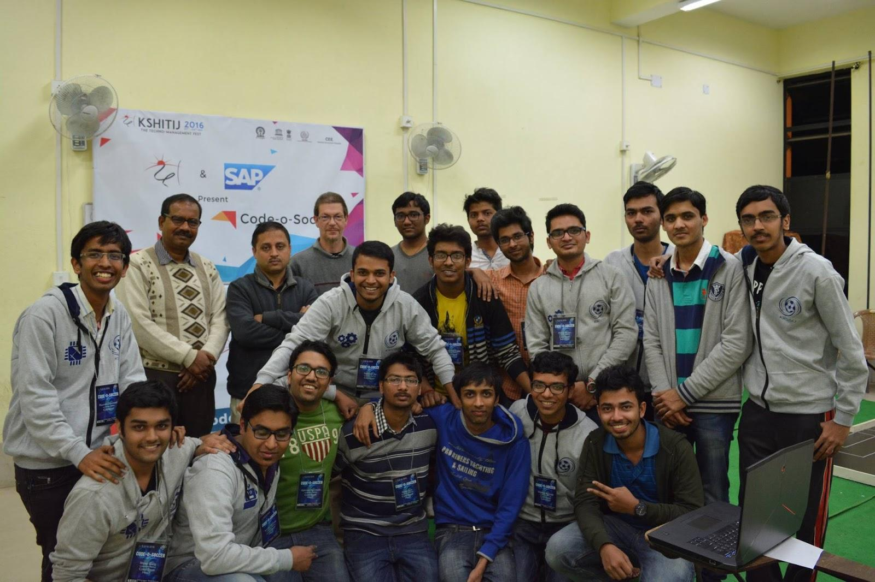
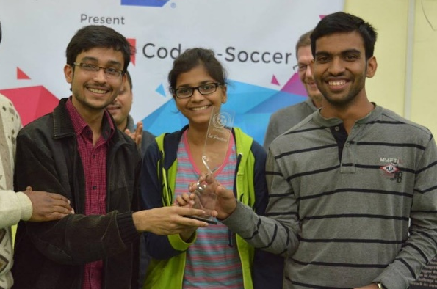
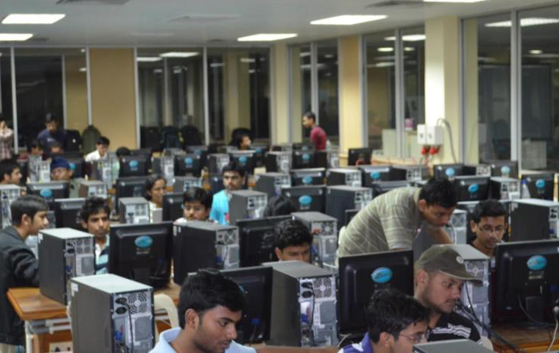
KRSSG
National Branding
KRSSG has been organising a national level strategic coding competition for the past 5 years. It is the first ever Artificial Intelligence based event implementing soccer strategies.
Round 1: Simulation League
Registrations and Submissions Online
Round 2: Hardware League
Top 20 Compete at IIT Kharagpur
Reach of the event:
Workshops in 5 colleges across various states
2018 – 200+ Registrations, 22 Colleges
2019 – 500+ Registrations, 43 Colleges
2020 – 500+ Registrations, 48 Colleges

Slide 10
KRSSG
Sponsoring
Robots
Banners
Website + Social Media
Team Jersey
The logo of Sponsor will be visible on all Robots.
Capture attention of International and National media on participations.
Banners with the logo and name of sponsors will be presented at International Participations, Code-O-Soccer (during Kshitij), workshops and research exhibitions.
Our website will have a link to the homepage of sponsor along with the name and logo of sponsor.
Publicity will be given to the sponsor on Facebook and Instagram handles of KRSSG and Kshitij.
Viewed by International robotics and Artificial Intelligence (AI) community.
The logo of sponsor will be on the t-shirt of all team members.
Presented during Participations and Code-O-Soccer.

Slide 11
KRSSG
Sponsoring
 | Title Sponsor ( >= INR 3 Lac) | Major Sponsor ( >= INR 2 Lac) | Associate Sponsor ( >= 1 Lac)
Team Jersey | ✔ | ✔ | ✔
Website + Social Media | ✔ | ✔ | ✔
Banners | ✔ | ✔
Robots | ✔

Slide 12
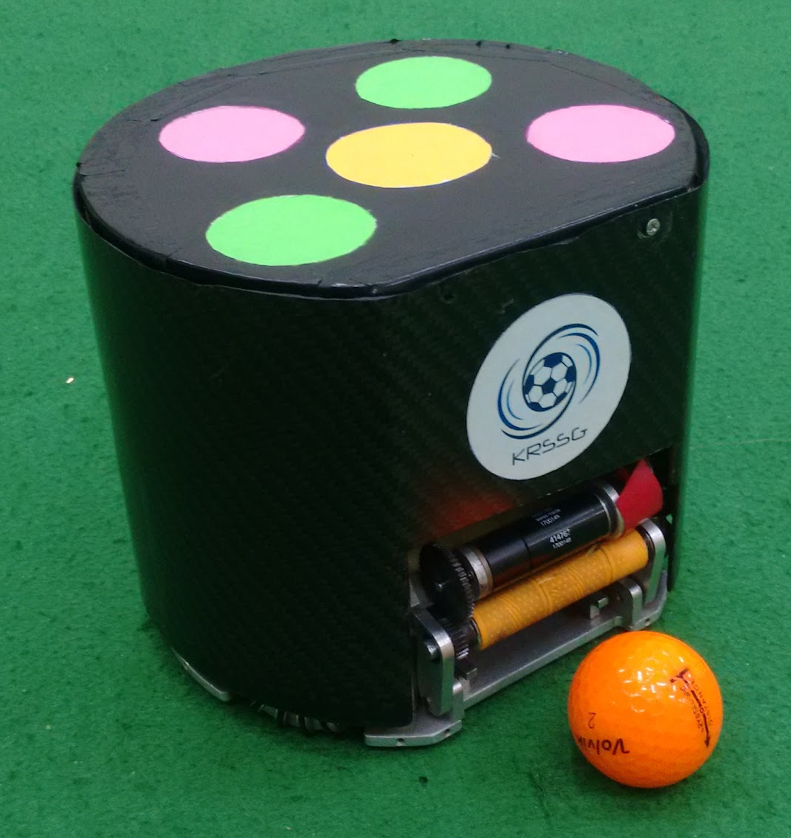
KRSSG
Making Difference
By sponsoring KRSSG, you can enable students to explore more in domain of Robotics and Artificial Intelligence.
Funds raised from sponsorships will go directly towards the construction of new robots for Robocup 2020. These funds will also be used to subsidize the cost of travel of students to attend RoboCup and provide an opportunity to learn more about the work done by other teams and return as future leaders of the project.
Furthermore, sponsorship will expose your company’s brand to international audience as we travel for competitions, as well as build your reputation with the local community.

Slide 13





KRSSG
Contact
Please contact us if you have further queries
Sudarshan Sharma
Project Leader
sudarshansharma04@gmail.com
+91-9051869264
Mayank Bhushan
Project Leader
miku.bhushan@gmail.com
+91-9800688333
Project In-charge
Prof. Jayanta Mukhopadhyay
Dept. of Computer Science & Engineering
IIT Kharagpur, India
Phone: +91 - 3222 – 283484
jay@cse.iitkgp.ernet.in
http://www.facweb.iitkgp.ernet.in/~jay/
krssg.in
fb.me/krssg
youtube.com/KRSSGIITKGP
instagram.com/_krssg_

